Slide 1
Chapter 14: Indexing

Slide 2
Chapter 14: Indexing
Basic Concepts
Ordered Indices
B⁺-Tree Index Files
B-Tree Index Files
Hashing
https://www.vertabelo.com/blog/technical-articles/an-introduction-to-mysql-indexes

Slide 3
Basic Concepts
Indexing mechanisms used to speed up access to desired data.
E.g., author catalog in library
Search Key - attribute to set of attributes used to look up records in a file.
An index file consists of records (called index entries) of the form
search-key
pointer

Slide 4
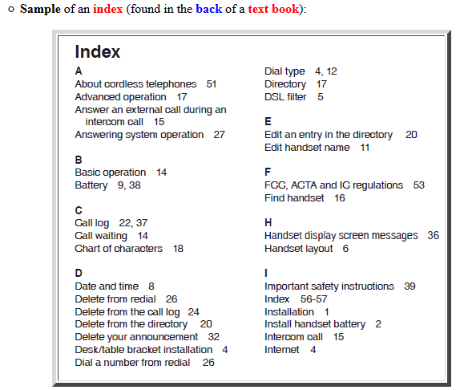
What is an index?

Slide 5
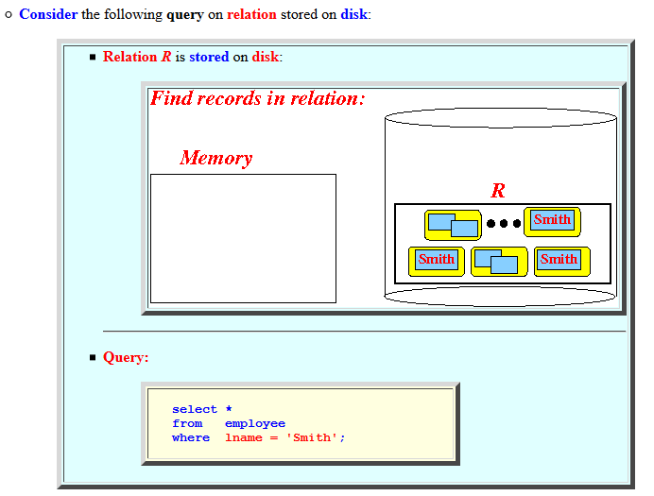
Example

Slide 6
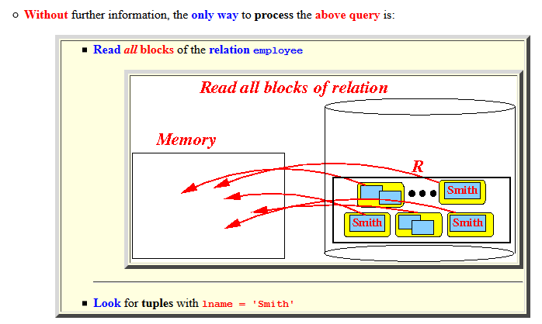
Example

Slide 7
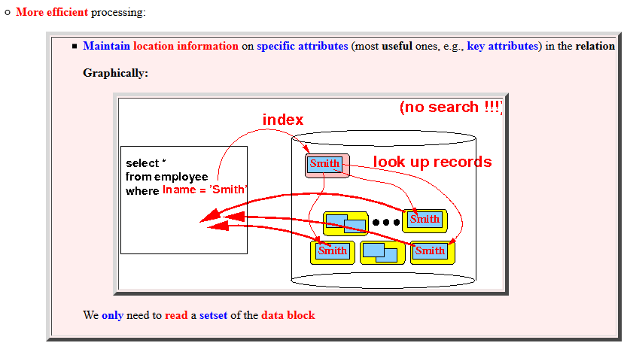
Example

Slide 8
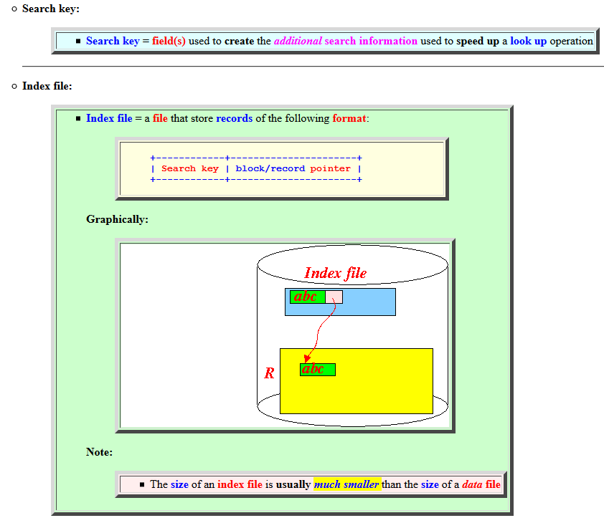
Definitions

Slide 9
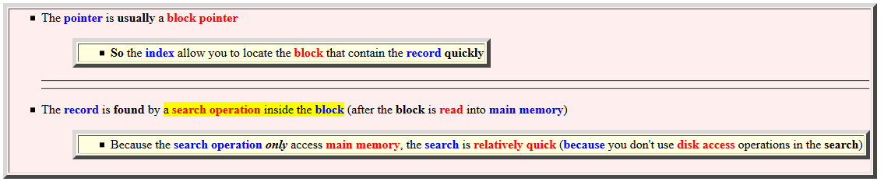
Note

Slide 10
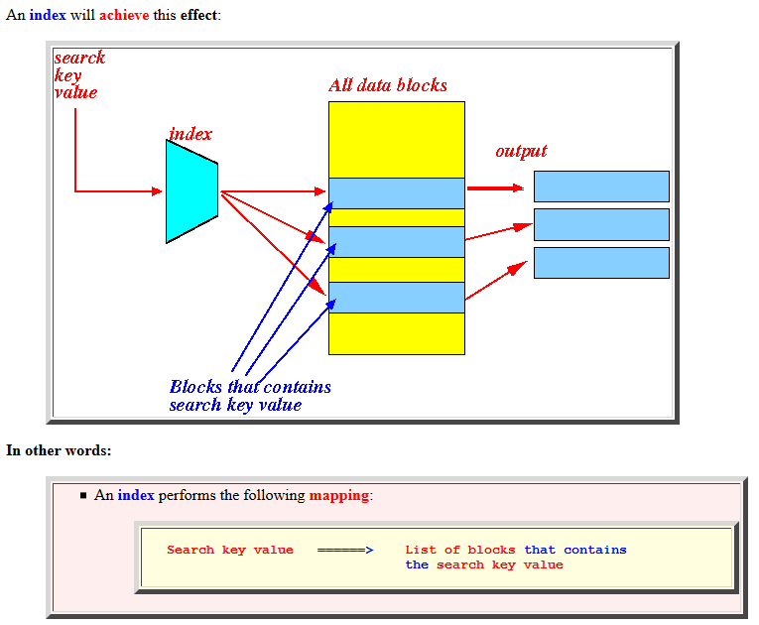
Basic Concepts of Indexing
Speed up data access
E.g., book indices

Slide 11
Index File
An index file is a computer file with an index that allows easy random access to any record given its file key.
An index file consists of records (called index entries) of the form
Index files are typically much smaller than the original file
Two basic kinds of indices:
Ordered indices: search keys are stored in sorted order
Hash indices: search keys are distributed uniformly across “buckets” using a “hash function”
search-key
pointer

Slide 12
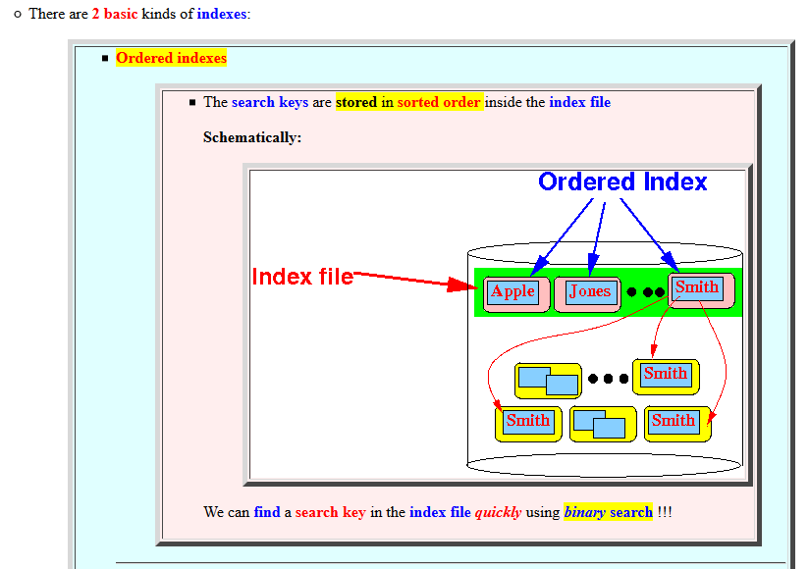
Type of index

Slide 13
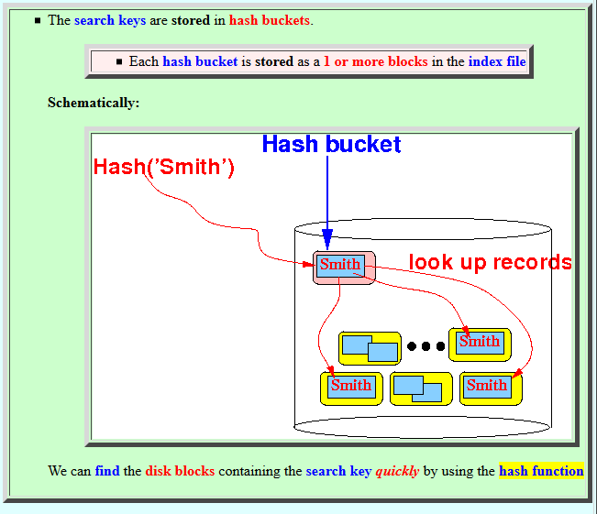
Hash Index

Slide 14
Index Evaluation Metrics
Access types supported efficiently. E.g.,
records with a specified value in the attribute
or records with an attribute value falling in a specified range of values.
Access time
Insertion time
Deletion time
Space overhead

Slide 15
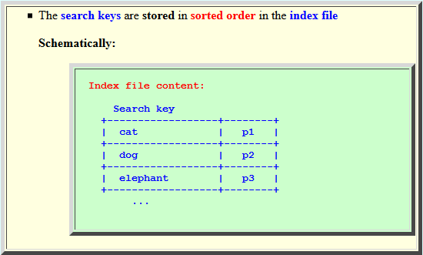
Ordered Indices
Index entries are sorted by search key values
E.g., author catalog in library.

Slide 16
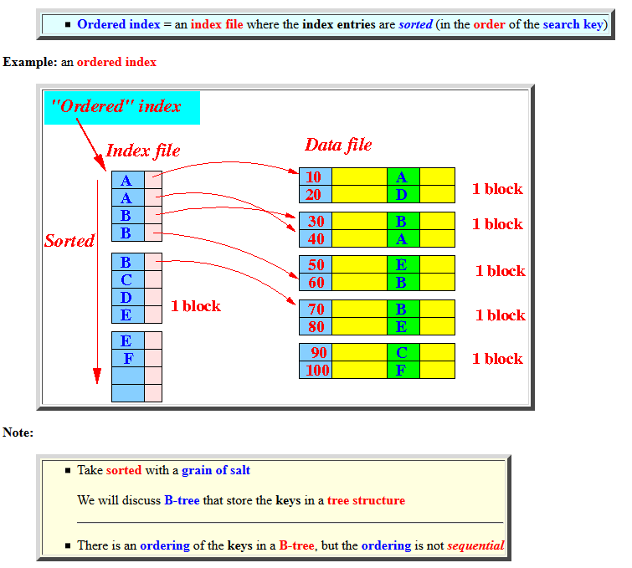
Ordered Index

Slide 17
Ordered Indices
Primary index (clustering index)
the index whose search key specifies the sequential order of the file
Index-sequential files: files ordered on a primary index
The search key of a primary index is usually the primary key
Secondary index (non-clustering index)
An index whose search key specifies an order different from the sequential order of the file.

Slide 18
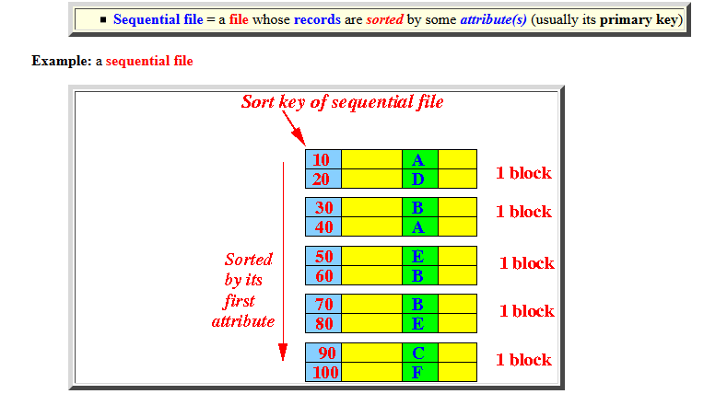

Sequential File (IBM's terminology....)

Slide 19
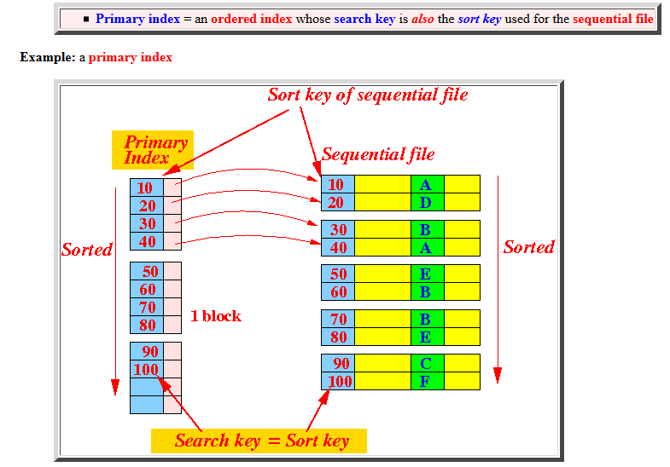
Primary Index (clustering index)

Slide 20
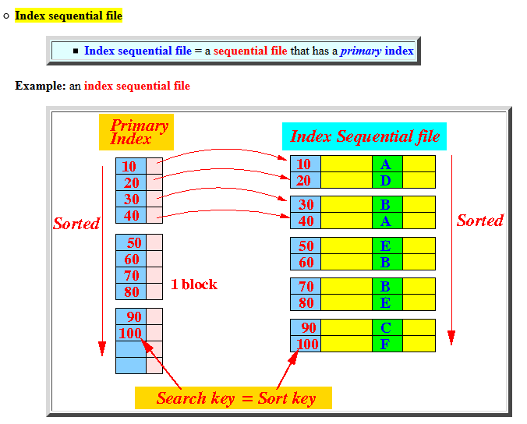
Index File

Slide 21
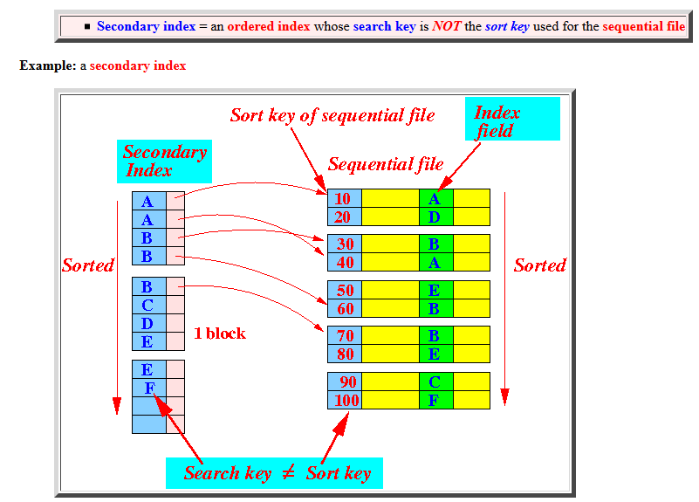
Secondary Index (non-clustering index)

Slide 22
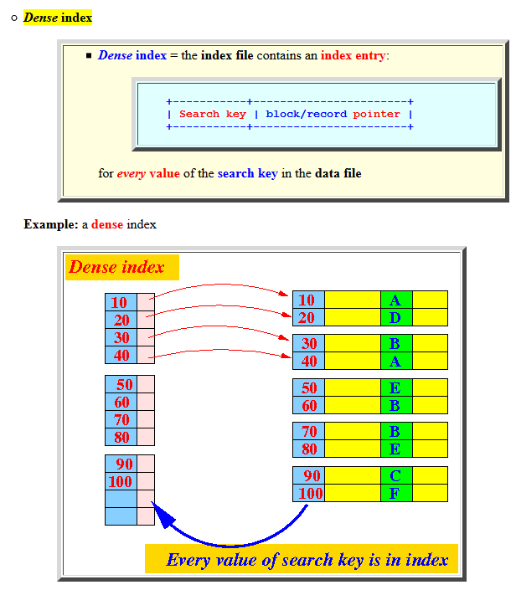
Dense Index

Slide 23
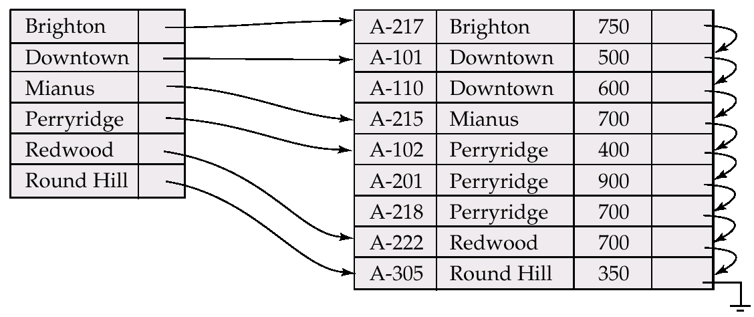
Dense Index Files
Dense index — Index record exists for every search-key value in the file.

Slide 24
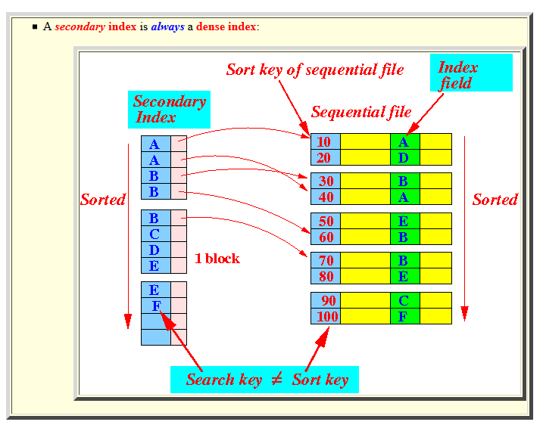
Note

Slide 25
Sparse Index Files
Sparse Index: contains index records for only some search-key values.
Applicable when records are sequentially ordered on search-key
To locate a record with search-key value K we:
Find index record with largest search-key value K
Search file sequentially starting at the record to which the index record points
Less space and less maintenance overhead for insertions and deletions.
Slower than dense index for locating records.
Good tradeoff: sparse index with an index entry for every block in file, corresponding to least search-key value in the block.

Slide 26
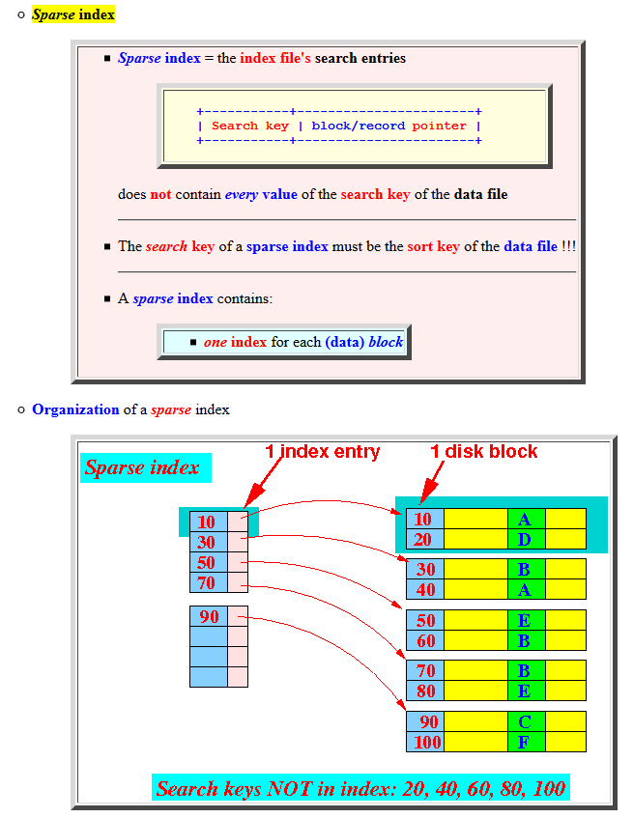
Sparse Index

Slide 27
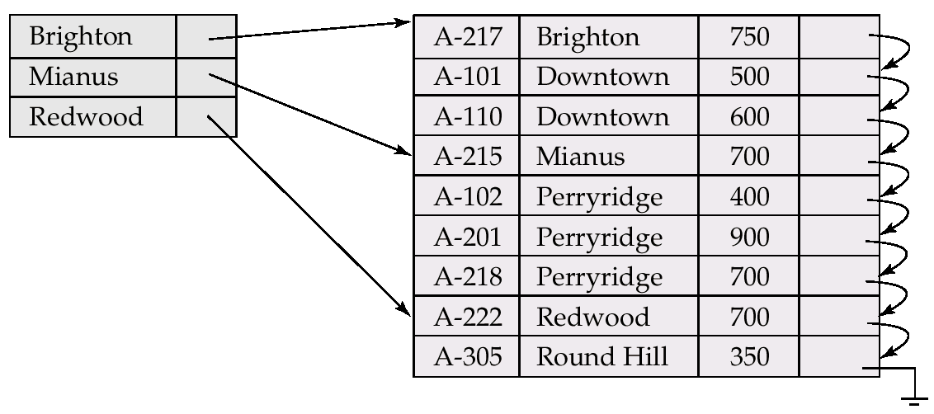
Example of Sparse Index Files

Slide 28
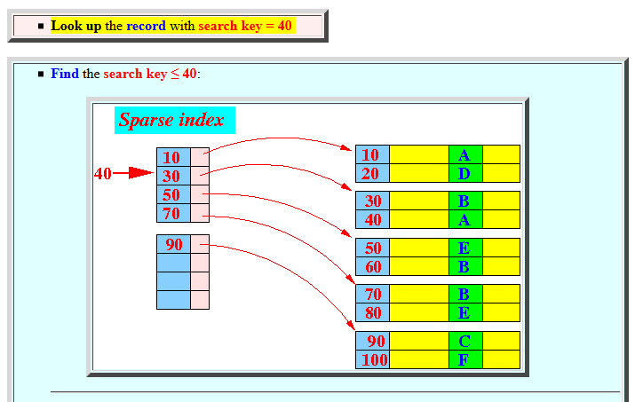
How to use a sparse index
Example:

Slide 29
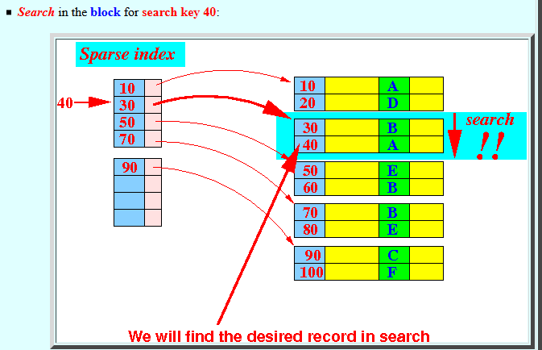

How to use a sparse index

Slide 30
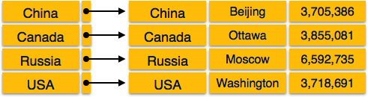
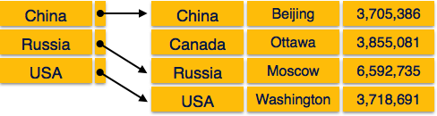
Examples
Dense Index:
Sparse Index:

Slide 31
Sparse clustering index
Austin
.
Ahmed
Austin
…
Dallas
.
Frank
Austin
…
Laredo
.
Brenda
Austin
…
Dana
Dallas
…
Emily
Dallas
…
Dino
Dallas
…
Carlos
Laredo
…
Amita
Laredo
…

Slide 32
Dense clustering index
Austin
Ahmed
Austin
…
Austin
Amita
Laredo
…
Austin
Brenda
Austin
…
Dallas
Carlos
Laredo
…
Dallas
Dallas
Dana
Dallas
…
Laredo
Dino
Dallas
…
Laredo
Emily
Dallas
…
Frank
Austin
…

Slide 33
Indexing the index
When index is very large, it makes sense to index the index
Two-level or three-level index
Index at top level is called master index
Normally a sparse index
"We can solve any problem by introducing an extra level of indirection, except of course for the problem of too many indirections."
David John Wheeler

Slide 34
Another realization
Austin
Ahmed
Austin
…
Dallas
.
Amita
Laredo
…
Laredo
.
Brenda
Austin
…
Carlos
Laredo
…
Dana
Dallas
…
We save space
and add one extra
level of indirection
Dino
Dallas
…
Emily
Dallas
…
Frank
Austin
…

Slide 35
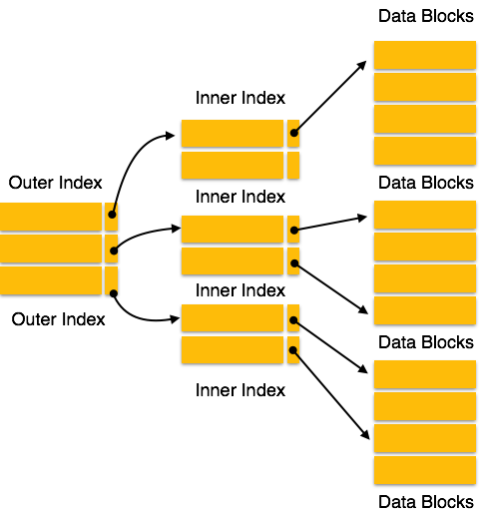
Two levels
AKA
Master Index Top Index

Slide 36
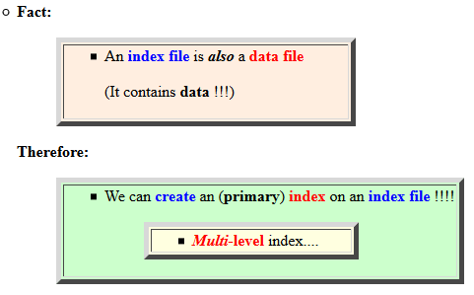
Multilevel Index

Slide 37
Multilevel Index
If primary index does not fit in memory, access becomes expensive.
To reduce number of disk accesses to index records, treat primary index kept on disk as a sequential file and construct a sparse index on it.
outer index – a sparse index of primary index
inner index – the primary index file
If even outer index is too large to fit in main memory, yet another level of index can be created, and so on.
Indices at all levels must be updated on insertion or deletion from the file.

Slide 38
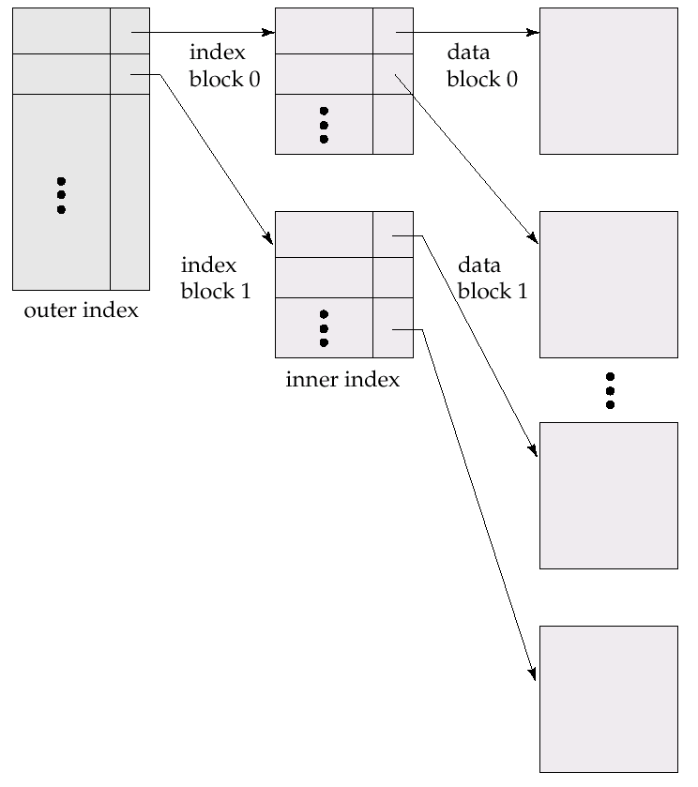
Multilevel Index (Cont.)

Slide 39
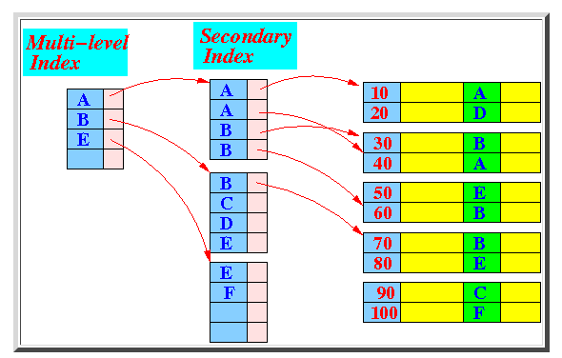
Multilevel Index Example

Slide 40
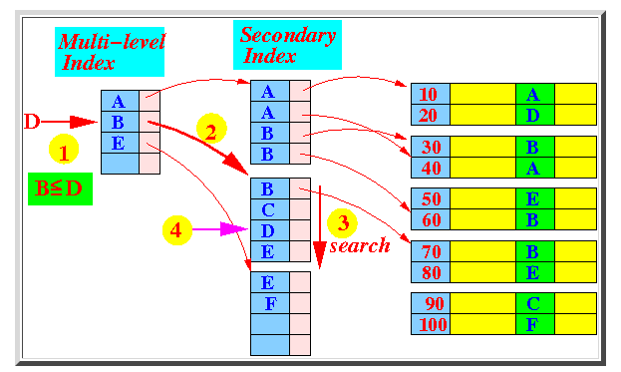
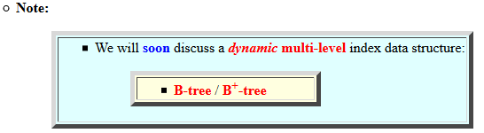
Multilevel Index
How to find the search key = D

Slide 41
B-tree and B+-tree
Please watch the video:
https://www.youtube.com/watch?v=aZjYr87r1b8

Slide 42
Example of B⁺-Tree

Slide 43
Creation of Indices
E.g. create index takes_pk on takes (ID,course_ID, year, semester, section) drop index takes_pk
Most database systems allow specification of type of index, and clustering.
Indices on primary key created automatically by all databases
Why?
Some database also create indices on foreign key attributes
Why might such an index be useful for this query:
takes ⨝ σ_{name='Shankar'} (student)
Indices can greatly speed up lookups, but impose cost on updates
Index tuning assistants/wizards supported on several databases to help choose indices, based on query and update workload

Slide 44
Index Definition in SQL
Create an index
create index <index-name> on <relation-name> (<attribute-list>)
E.g.: create index b-index on branch(branch_name)
Use create unique index to indirectly specify and enforce the condition that the search key is a candidate key is a candidate key.
Not really required if SQL unique integrity constraint is supported
To drop an index
drop index <index-name>
Most database systems allow specification of type of index, and clustering.

Slide 45
End of Chapter 14

